Slide 1
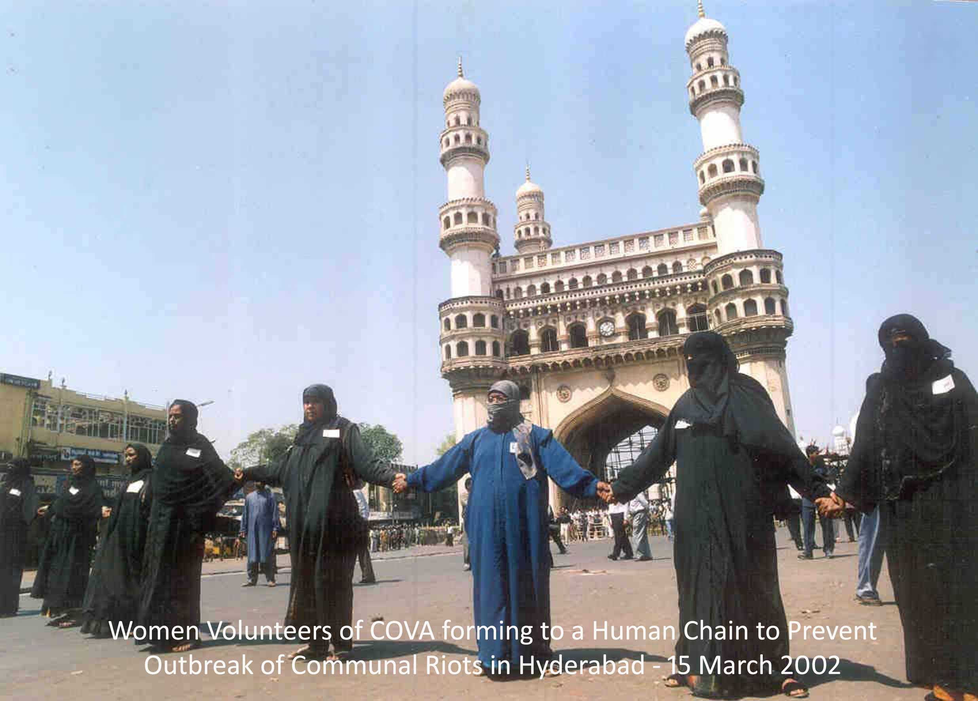
COVA CCCCCCCCo Communal Harmony Networking-Research- Advocacy- Structural Transformations For a Peaceful and Egalitarian Society

Slide 2
COVA
Networking for Empowerment and Peace
Local / National / International
Extensive networking with over 3000 civil society organisations, institutions, corporates, advocacy platforms and media houses for multiplier effect.
Work in Five States of India, Eight Countries of South Asia and Four Countries of Far East
Sensitisation and engagement of children, women, youth and professionals on different social issues.
Specific initiatives to empower the underprivileged to leverage existing policies and programs for education, health and financial inclusion.
Promote dialogue for regional peace and development.

Slide 3
3rd Generation Philanthropy From Charity to Empowerment
For Exponential Impact of Individual Donations
To Facilitate Poor to Access Government Schemes And Programs
Pre-Matric Scholarship Project facilitates students to access Government scholarships. During 2017-18 COVA enabled 3,011 students from 24 schools of Hyderabad to get scholarships of about 1 Crore. The amount spent by COVA on this Project was Rs. 1.62 lakhs, the Return on Investment (ROI) is 1:63.
Financial Inclusion Project aims to provide financial literacy to the people to enable them to directly access loans from banks. It is the right of each citizen as stipulated by the Government of India and Reserve Bank of India under various schemes like DRI (Differential Rate of Interest) loans, Priority Sector Lending, and Prime Minister’s 15- Point Program for Minorities and MUDRA, etc. Total Amount of loans accessed till 31st July 2018 is Rs: 2.20 Crores. Total Amount spent by COVA was Rs: 17 Lakh.
Citizens’ Assertion Campaign-Enabling citizens of Hyderabad to access 56 civic services from the Municipal Corporation, Water Works and Electricity Departments. Links to GHMC, HMWS&SB, TSSPDCL respective Citizen’s Charter on COVA Website were included and inaugurated by the GHMC Commissioner Mr. Janardhan Reddy who also released the pamphlets, posters and standees of the campaign, 40,000 pamphlets were distributed. The Campaign has achieved a phenomenal increase of 46.7% in download of GHMC App by members of the public.
Make Poverty History!

Slide 4
COVA: Empowering India
Other On Going Projects:
Compassionate Citizenship and Responsible Activism Programme in Hyderabad covers 100 schools, 20 colleges, and 5 universities. The Campaign is to Provide A Systematic And Sustained Sensitization To A Range Of Social Issues And Concerns To School, College And University Students, Corporate Youth And Professionals.
Implementation of RTE Act for providing 25% free admissions for poor students in private schools. 8 million children can benefit in Telangana State. PIL filed by COVA in the matter is pending with the High Court.
Work with 5000 Refugees from 12 countries living in Hyderabad to provide them medical, health, educational and psychosocial support.
Engagement with National networks in India and multilateral platforms like BRICS, G20, SAARC, CHOGM, UN Processes like SDGs etc.. for structural transformation for an equitable, sustainable and just world order.

Slide 5
COVA: Current Innovations I. Peace Now and Forever Campaign Between Pakistan and India: Objective: Addressing deteriorating relations between Pakistan and India Strategy: 1. Provide platforms to enable common people and civil society to demand peace and condemn war mongering 2. Campaign organised in over 100 cities and towns of India and Pakistan and some other countries. II. COFI ( Cyber Operations for Fraternity and Integration) Networks 1. In 6 countries of South Asia and 4 countries of Far East Enabling faith leaders, media personel, academics, activists and youth to leverage social media to counter hate campaigns and propagate inclusion and peace 2. CHECK IT: Addresses the issues of Fake News. CHECK IT will sensitise and educate people to delink the perceived legitimacy of all printed word and broadcasted messages and properly verify the veracity before accepting and more importantly sharing it with others, especially on social media platforms to secure cyberspace for peace. 3. The HUB: Enabling eminent personalities with positive ideologies to propagate their writings and speeches through different social media platforms for wider reach and set the agenda of positivity on social media.

Slide 6
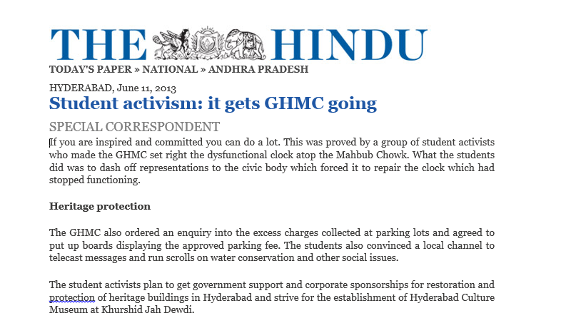
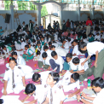
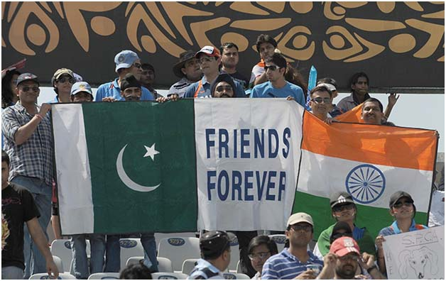
COVA: Policy Transformations Some Successes
Position Paper for Socio Economic and Political Transformation of Telangana through Ten Strategic Interventions

Slide 7
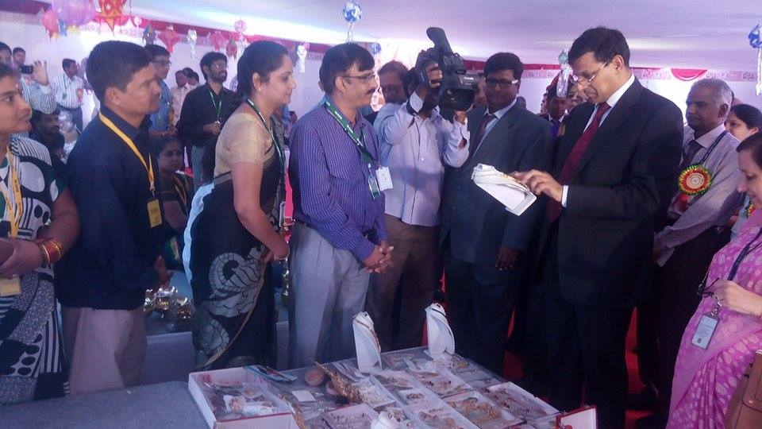
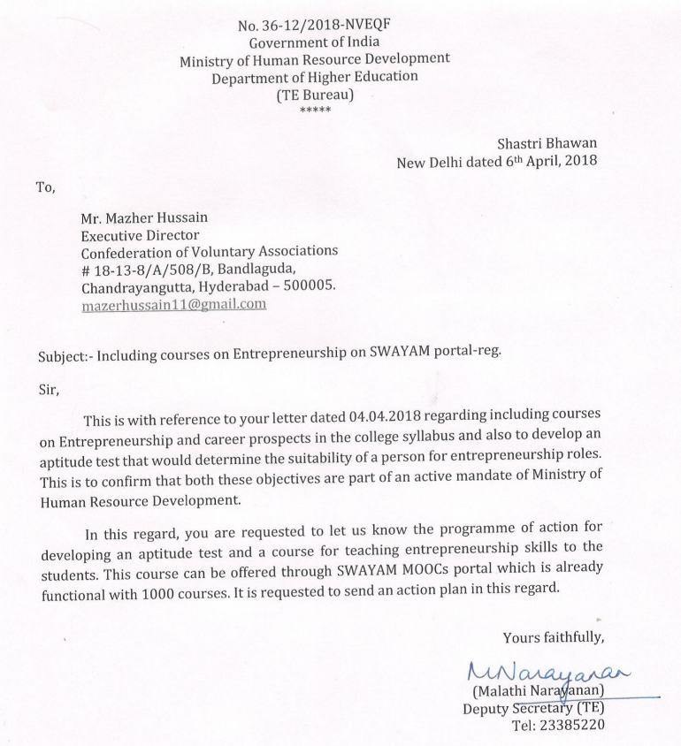
COVA: Empowering G 20 and BRICS
On Going Projects:
Financial Inclusion Program to enable poor and lower middle classes to access Bank Loans- 8 of 12 Policy Recommendations of COVA Accepted by the Government of India- 90 million people can benefit.
Study of MSMEs in BRICS Economies- Three Paradigm Shifts and Twelve Strategic Recommendations to promote micro and small enterprises under consideration by the Government of India and Government of Telangana. Ministry of HRD has accepted 3 of the Recommendations relating to redesign of school and college syllabus to provide orientation to entrepreneurship.

Slide 8
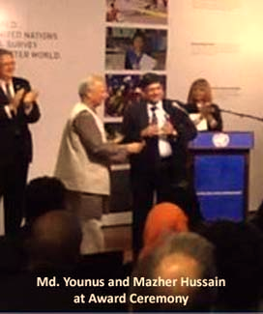
COVA: International Engagements
Policy interventions for Empowerment through Structural Transformations
Policy Engagement with State and National Governments, Multilateral Bodies like the UN, Commonwealth, G 20, BRICS and SAARC for structural transformation for an equitable, sustainable and just World Order.

Slide 9
Thank You for your continued support Together, We can achieve!

