Slide 1
COMPASSIONATE CITIZENSHIP PROGRAM LECTURE ON Climate Change Framework Provided By Ms. Nikita Naidu Pilot Project By In Collaboration With SCERT (Telangana State)
Notes:
Request for Resource Persons
We thank you for accepting to partner with the Compassionate Citizenship Program as a Resource Person.
The objectives of the Compassionate Citizenship Program are to introduce students to different social issues through lectures, train them in basic methods of social sciences to study the issues in a systematic way, come up with specific and practical solutions for the issues and undertake action to address / solve the issues
This lecture is the beginning of the process and apart from giving an overview of the topic, should also facilitate students to identify different issues that arise from the topic to select and address one issue.
There are two slides at the end about undertaking Project Works and examples of some issues, subjects for interviews and possible questions.
Please consider devoting about 10 minutes to this Section. Thanks

Slide 2
Climate Change
Exploring the Impact of Climate Change and Strategies for the Future
Understanding Weather and Climate
The Science Behind Climate Change
Current Impacts of Climate Change
Adaptation Strategies
Mitigation Efforts
Conclusion and Call to Action

Slide 3
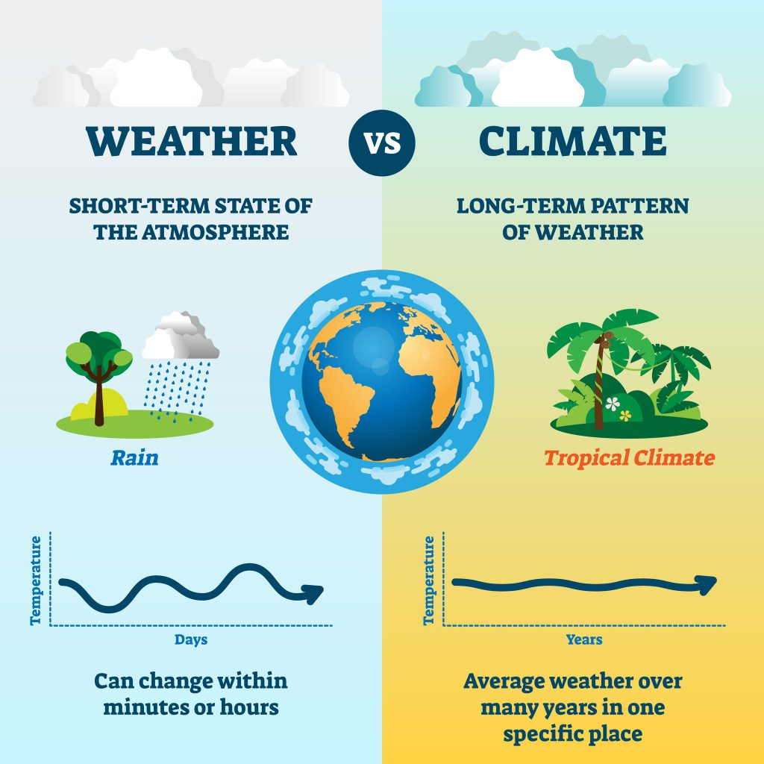
Climate Change
Understanding Weather and Climate Distinguishing Between Weather and Climate for Climate Change Insights
Short-term vs Long-term
Weather represents daily atmospheric conditions, while climate refers to averages over decades.
Importance of Differentiation
Understanding the difference is crucial for effective climate change discussions and policies.
Human Influence
Human activities, particularly greenhouse gas emissions, significantly alter both weather patterns and climate.
Impact on Ecosystems
Shifts in climate affect biodiversity, altering habitats and species survival rates.

Slide 4
Climate Change
The Science Behind Climate Change
Understanding Human Impact on Atmospheric Changes
1. Burning Fossil Fuels
Combustion of coal, oil, and gas releases CO2, significantly raising greenhouse gas levels.
2. Deforestation
Tree removal decreases CO2 absorption, worsening atmospheric imbalance and contributing to warming.
3. Industrial Activities
Manufacturing processes emit greenhouse gases, adding to the atmospheric changes driving climate change.
4. Greenhouse Effect
Increased greenhouse gas concentrations trap heat, resulting in global temperature rise and climate disruptions.

Slide 5
Climate Change
The Greenhouse Effect
Understanding the Natural Phenomenon of Heat Retention in Our Atmosphere
Key Greenhouse Gases
Major contributors like CO2, CH4, and N2O are essential in trapping heat.
Human Impact
Increased CO2 from fossil fuels significantly amplifies the greenhouse effect.
Temperature Rise
Global temperatures are rising, leading to severe climate consequences.
Weather Patterns
Altered weather patterns disrupt ecosystems and human activities.

Slide 6
Climate Change
Extreme Weather Impacts of Climate Change
Flash Floods
disrupt public and private infrastructure, causing significant damage and displacing residents.
Eg. Pakistan floods
Heat Waves
Record temperatures crossing 50 degree celcius have threatened public health and reduced agricultural yields.
Eg. Telangana and AP 2015
Sea Level Rise
Coastal regions and small Island Nations face increasing threats from rising sea levels, risking homes and ecosystems.
Eg. Carteret Islands
Droughts
The frequency of droughts has surged, leading to severe water scarcity and impacting livelihoods.
Eg. Maharashtra and Kerala
Wildfires
Escalating wildfires, resulting in devastating damage to ecosystems and communities.
Eg. Australia and Brazil

Slide 7
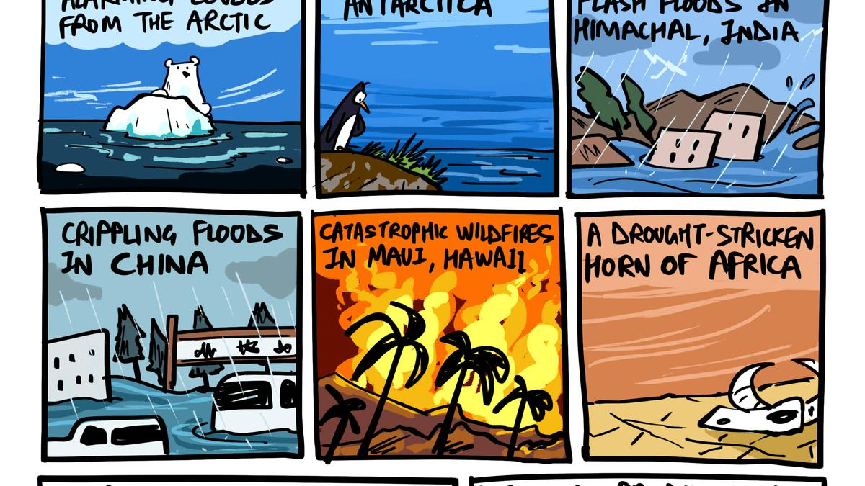

Slide 8
Climate Change
ADAPTATION STRATEGIES Key Approaches to Mitigate Climate Change Vulnerability
Enhancing Adaptive Capacity
Focus on improving community resilience and readiness for climate challenges through training and infrastructure improvements.
Reducing Vulnerability
Implement protective measures such as early warning systems and safe zones for populations at high risk from climate impacts.
Strengthening Resilience
Build robust systems capable of withstanding climate impacts, ensuring sustainability in agriculture, water supply, and health services.

Slide 9
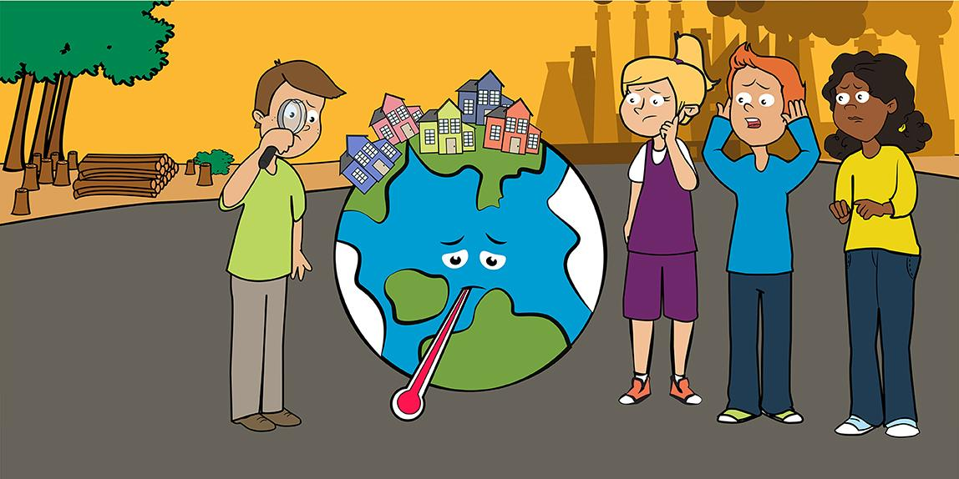
Climate Change
Mitigation Efforts
Strategies to Combat Climate Change Through Emission Reduction
Transition to Renewable Energy
Utilizing sources like solar, wind, and biomass to decrease emissions.
Enhance Energy Efficiency
Improving technology and practices to use less energy for the same output.
Promote Sustainable Land Use
Implementing practices that maintain ecological balance and conserve resources.

Slide 10
Climate Change
Conclusion
Navigating Climate Change: Challenges and Opportunities Ahead
Understanding Climate Science
Grasping the fundamentals of climate science is crucial for informed action. This knowledge helps in recognizing trends and impacts.
Acknowledging Impacts
Recognizing the diverse impacts of climate change on ecosystems and communities is essential for effective response strategies.
Innovative Solutions
Embracing innovation can lead to sustainable technologies and practices that mitigate climate effects and enhance resilience.
Collaborative Action
Collaborative efforts among governments, businesses, and communities can amplify the impact of climate initiatives and ensure broader reach.
Strategic Implementation
Implementing effective strategies is vital for achieving long-term sustainability goals and addressing climate change comprehensively.

Slide 11
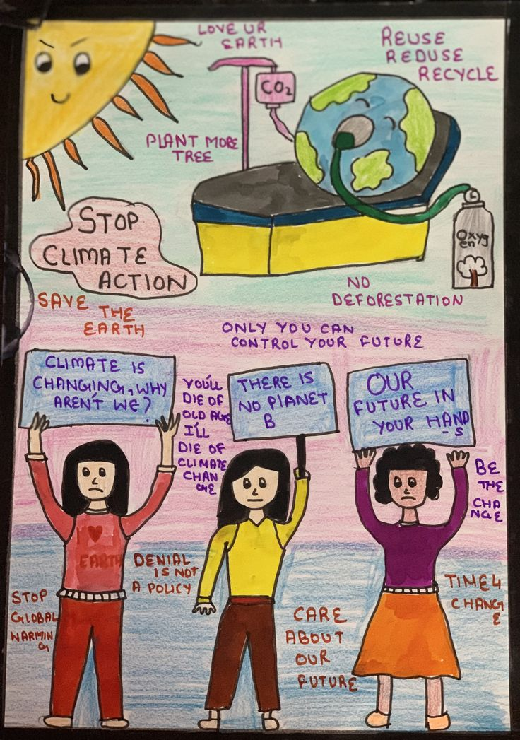
Climate Change

Slide 12
Thank You

